Slide 1
Class Modeling
Notes:
Lecture #11: IT60105
D. Samanta, SIT, IIT Kharagpur

Slide 2
Lecture
Domain class model
  Finding classes
    Keeping the right classes
  Finding associations
    Keeping the right associations
  Finding attributes
    Keeping the right attributes
  Finding methods
Grouping classes into packages
Notes:
Lecture #11: IT60105
D. Samanta, SIT, IIT Kharagpur

Slide 3
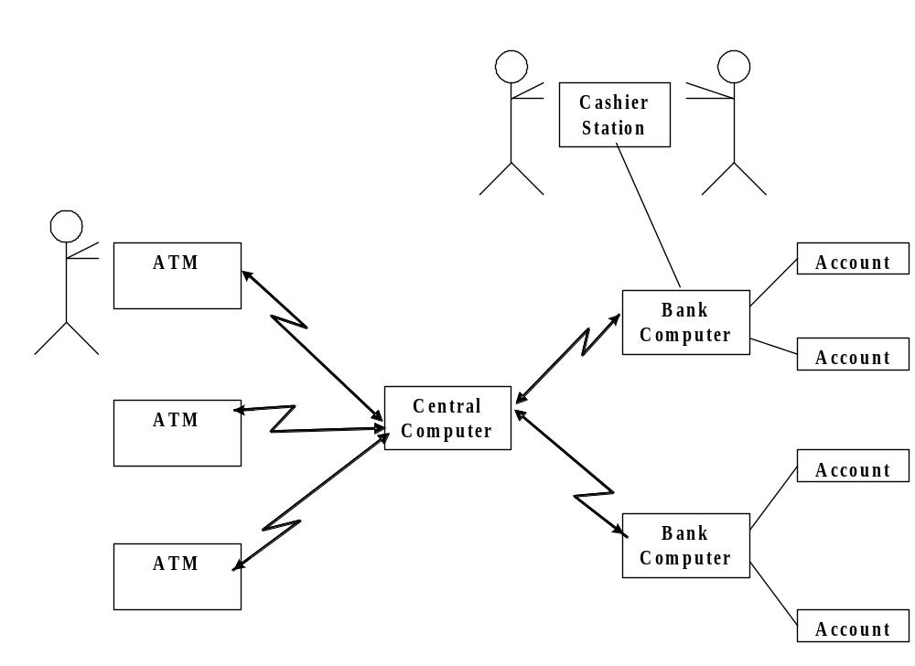
Case Study: ATM System
Notes:
Lecture #11: IT60105
D. Samanta, SIT, IIT Kharagpur

Slide 4
ATM System: Problem Statement
Design the software to support a computerized banking network including both human cashiers and automatic teller machines (ATMs) to be shared by a consortium of banks. Each bank provides its own computer to maintain its own accounts and process transactions against them. Cashier stations are owned by individual banks and communicate directly with their own bank’s computers. Human cashiers enter account and transaction data.
Automatic teller machines communicate with a central computer that clears transactions with the appropriate banks. An automatic teller machine accepts a cash card, interacts with the user, communicates with the central system to carry out the transaction, dispenses cash, and prints receipts. The system requires appropriate recordkeeping and security provisions. The system must handle concurrent accesses to the same account correctly.
The banks will provide their own software for their own computers; you are to design the software for the ATMs and the network. The cost of the shared system will be apportioned to the banks according to the number of customers with cash cards.
Notes:
Lecture #11: IT60105
D. Samanta, SIT, IIT Kharagpur

Slide 5
Find Classes
To find the relevant classes for objects from the problem domain
  Not all classes are explicit in the problem statement
  Some are implicit in the application domain or general knowledge
We can find many classes by considering nouns
Notes:
Lecture #11: IT60105
D. Samanta, SIT, IIT Kharagpur

Slide 6
ATM System: Find Classes
Design the software to support a computerized banking network including both human cashiers and automatic teller machines (ATMs) to be shared by a consortium of banks. Each bank provides its own computer to maintain its own accounts and process transactions against them. Cashier stations are owned by individual banks and communicate directly with their own bank’s computers. Human cashiers enter account data and transaction data.
Automatic teller machines communicate with a central computer that clears transactions with the appropriate banks. An automatic teller machine accepts a cash card, interacts with the user, communicates with the central system to carry out the transaction, dispenses cash, and prints receipts. The system requires appropriate recordkeeping and security provisions. The system must handle concurrent accesses to the same account correctly.
The banks will provide their own software for their own computers; you are to design the software for the ATMs and the network. The cost of the shared system will be apportioned to the banks according to the number of customers with cash cards.
Notes:
Lecture #11: IT60105
D. Samanta, SIT, IIT Kharagpur

Slide 7
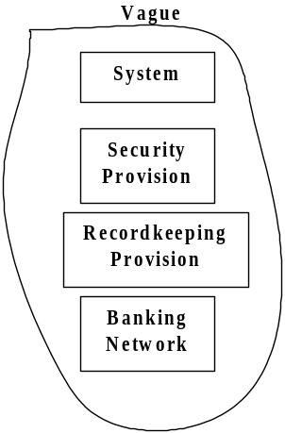
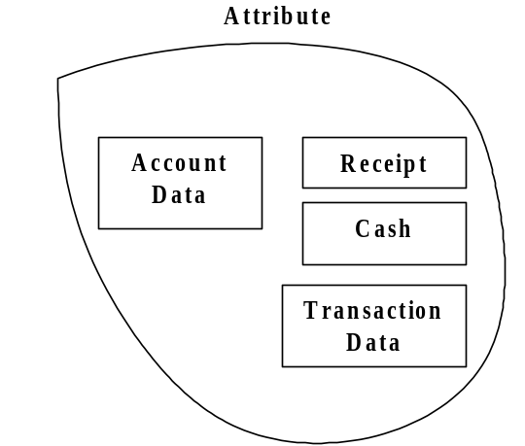
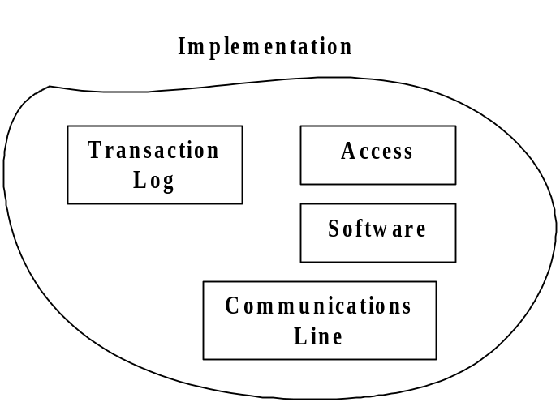
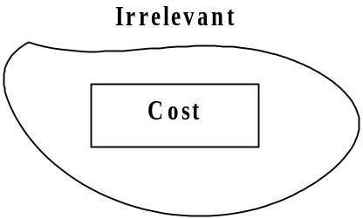
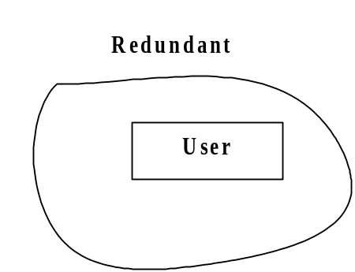
ATM System: Bad Classes
Notes:
Lecture #11: IT60105
D. Samanta, SIT, IIT Kharagpur

Slide 8
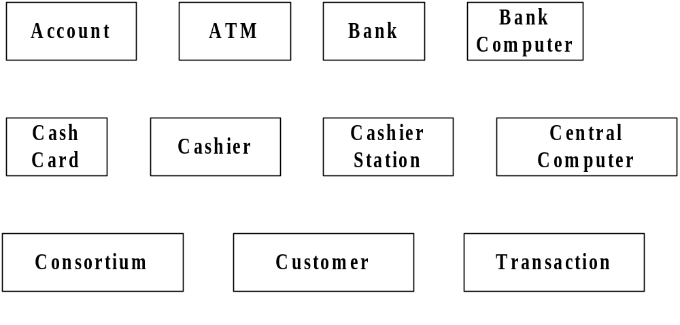
ATM System: Good Classes
Notes:
Lecture #11: IT60105
D. Samanta, SIT, IIT Kharagpur

Slide 9
Find Associations
Apply all or appropriates
  Find Verb phases
  Implicit verb phases
  Knowledge of problem domain
Notes:
Lecture #11: IT60105
D. Samanta, SIT, IIT Kharagpur

Slide 10
ATM System: Find Associations
Verb phases
Banking Network includes cashier stations and ATMs
Consortium Shares ATMs
Bank provides bank computer
Bank computer maintains accounts
Bank computer process transaction against account
Bank owns cashier Station
Cashier station communicates with bank computer
Cashier enters transaction for account
ATMs communicate with central computer about transaction
Central computer clears transaction with bank
ATM accepts cash card
ATM interacts with user
ATM dispense cash
ATM prints receipts
System handles concurrent access
Bank provide software
Cost apportioned to banks
Notes:
Lecture #11: IT60105
D. Samanta, SIT, IIT Kharagpur

Slide 11
ATM System: Find Associations
Implicit verb phases
Consortium consists of banks
Bank holds account
Consortium owns central computer
System provides recordkeeping
System provides security
Customers have cash cards
Knowledge of problem domain
Cash card accesses accounts
Bank employs cashiers
Notes:
Lecture #11: IT60105
D. Samanta, SIT, IIT Kharagpur

Slide 12
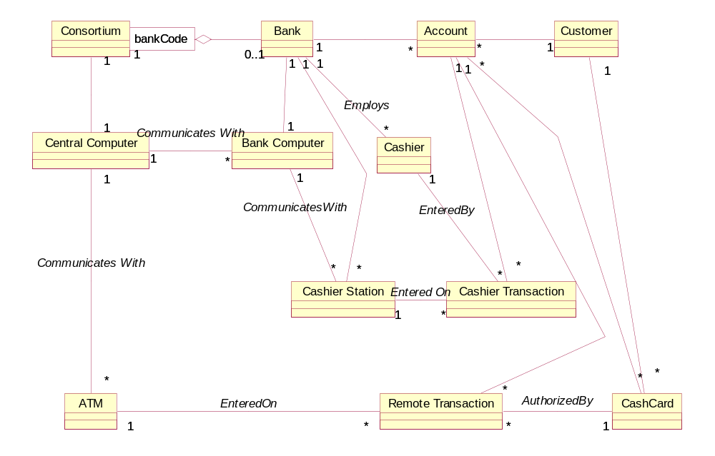
ATM System: Class Diagram
Notes:
Lecture #11: IT60105
D. Samanta, SIT, IIT Kharagpur

Slide 13
Finding Attributes
Consider attributes directly relevant to the application
  Get the most important attributes first
  Add fine details later
  Avoids attributes those are solely for implementation
  Be sure to give each attribute a meaning full name
Notes:
Lecture #11: IT60105
D. Samanta, SIT, IIT Kharagpur

Slide 14
Keeping Right Attributes
Eliminate unnecessary and incorrect attributes with the following criteria
  Objects
    Careful about right objects as attributes in the class
  Qualifiers
    Which actually matters
  Names
    A name is an attribute when its use does not depends on context
Notes:
Lecture #11: IT60105
D. Samanta, SIT, IIT Kharagpur

Slide 15
Find Methods
Decide the operations require to manipulate the members within and other objects
Use other models as well
  Sequence diagrams
  Statechart diagrams
Notes:
Lecture #11: IT60105
D. Samanta, SIT, IIT Kharagpur

